Slide 1
Increasing Trust in the Internet
Triple I: a GFCE Capacity-building project
RIPE NCC Regional Meeting Almaty, 25 September 2018
Maarten Botterman

Slide 2

“What to do to improve justified trust in using the Internet and email in the region”
Purpose of the Day

Slide 3
Internet Infrastructure Initiative
Aim: to help build a robust, transparent and resilient internet infrastructure.
Rationale: A robust, open and resilient internet infrastructure is key to counter infringements and threats to the cyber domain, and increases justified trust, as it:
  diminishes the chances and impact of cyber-attacks (like DDoS) and cybercrime (hacking malware, phishing, botnets) and SPAM.
  enables the public to maintain confidence and trust;
  is a precondition for the use of the internet as a means to boosting innovative and economic activities.
Offering: this Initiative seeks to deepen and broaden the know-how in locally applying, testing and monitoring compliance with widely agreed open internet standards.
  Key elements include national internet infrastructure protection, internet exchange points, registries, open source software, email security and routing security.

Slide 4
Setting up Capacity building events
Targeted at regions that are catching up
Bringing together regional stakeholders
Awareness raising on Open Internet Standards
Inspiration through Good Practice Examples
Impact through joint commitment for action

Slide 5






Supported by global and regional stakeholders
GFCE members
  Governments
  International Organisations
  Businesses
Regional Internet Registries
  All regions
Internet Society
  Global office
  Local chapters
NL Ministry of Economic Affairs

Slide 6
PANEL AGENDA
Intro GFCE Triple-I
Maarten Botterman
Intro: Better Use of Today’s Open Internet Standards
Hisham Ibrahim (RIPE NCC)
Inspiration from Good Practice: joint mitigation of DDOS
Aiko Pras (Professor, Twente University - via video)
Panel discussion: Increasing Trust in the use of Internet and e-mail
Kristina Hakobyan (CEO, Global AM); Yuriy Kargapolov, (Chair, ISOC IoT SIG);
Talant Sultanov (Chair, Internet Society-Kyrgyz Chapter), Bakhrom Nasirjanov
(Megafon Tajikistan)

Slide 7
From State-of-Practice to State-of-the-Art, together
Joint priority setting and action planning

Slide 8
Next events under preparation
Almaty, Kazachstan, hosted by RIPE NCC, supported by RIPE/ISOC/Kazachstan Telecom, 25 September 2018
Delhi, India, hosted by Indian Summerschool for Internet Governance, supported by ISOC/APNIC/Indian Govt, 12 October 2018
Daejeon, Korea, hosted by APRICOT2019,supported by APNIC/ISOC/dotASIA, 23 February 2019
WWW.THEGFCE.COM

Slide 9
Help make the Internet more reliable in your region
Contribute with good practice examples to events
1
Support an event in your region as co-organizer or participant
2
Improve the reliability of Internet by taking action
3

Slide 10
Triple I is a GFCE project
www.thegfce.com
For more information contact:
maarten@gnksconsult.com

Slide 11
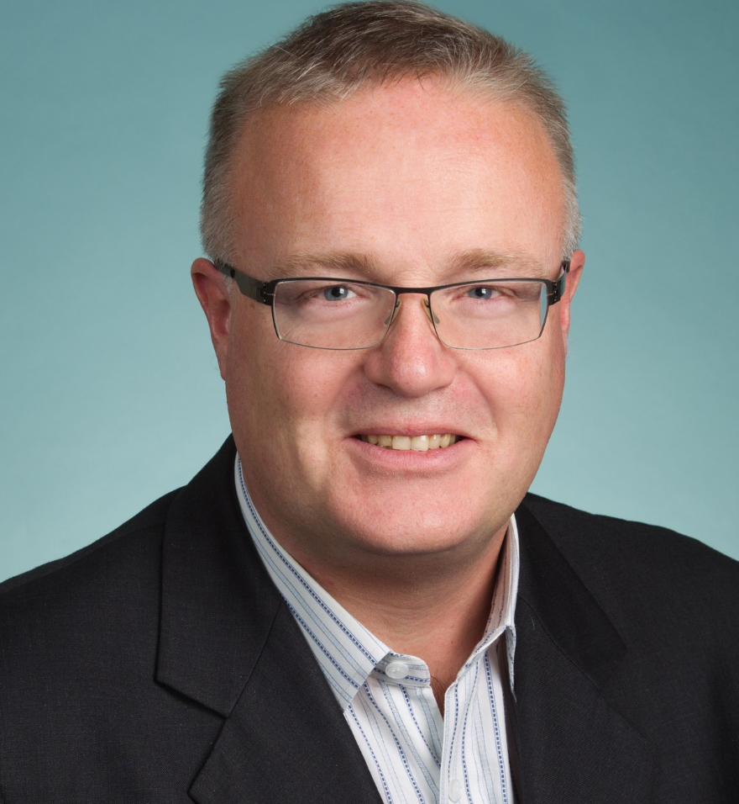
About Maarten Botterman
More than 25 years experience with work “in
the public interest”: where connected technologies
touch society - internationally
Independent analyst, strategic advisor, moderator and
chairman, see for more: www.gnksconsult.com
Currently chairing: IGF Dynamic Coalition on Internet of
Things (www.iot-dynamic-coalition.org/); PICASSO Policy
Expert Group (www.Picasso-project.eu), and Supervisory Board of NLnet Foundation (www.nlnet.nl.)
ICANN Board Member (www.icann.org)
Full CV: https://www.linkedin.com/in/botterman
Email: maarten@gnksconsult.com

